Slide 1

Memory Skills Group
Week 3 : External memory enhancement strategies
Rebecca Niebieszczanski (Trainee Clinical Psychologist)
Kirsty Ellis (Assistant Psychologist)
Lesley Stewart (Consultant Clinical Neuropsychologist)
Revised 2021
Grace Sunerton (Assistant Psychologist)
Alice Roblin (Senior Clinical Psychologist)

Slide 2

Welcome!
Notes:
Welcome participants to the group
Explain that the group is for individuals who report difficulties with their memory
Important that we have realistic expectations that the group is not about ‘getting rid’ of our memory difficulties
The group will offer skills and information that will help us to manage these memory difficulties
2 hours with break

Slide 3




Housekeeping:
Notes:
Breaks – including toilet breaks
No recording of the session
Mobile phones on silent/vibrate to minimise distractions

Slide 4
Overview of the course:
Session 1 Introductions and an overview of cognitive abilities
Session 2 Overview of memory
Session 3 External memory enhancement strategies
Session 4 Internal memory enhancement strategies
Session 5 Mood and cognitive functioning
Session 6 Keeping well, course reviews and goodbyes
Notes:
6x 2 hour sessions
The emphasis of this group is active participation and it is equally important to contribute as much as you feel you can.
It is also important that you attend all the sessions, however, if for some reason you can’t attend the group - let us know
Taught materials
Discussions
Exercises and chances to practice
Contact details in booklet if need additional support, talk to facilitators
Facilitators might make notes throughout to remember content of session

Slide 5
Session outline
Mindfulness exercise
Recap on the previous session
Communicating cognitive difficulties to others
Overview of external memory strategies
Out-of-session work.

Slide 6
Mindfulness exercise

Slide 7
Recap of previous session
Welcome and grounding exercise
Exploring the memory process (attention, information processing, encoding, storage, retrieval)
Why do people experience memory difficulties?
How are people with memory difficulties affected?
Out of session work.

Slide 8

Reviewing weekly goals
Trying out a new memory strategy for the week:
Were you able to do it?
Was it difficult to do?
Was it helpful/unhelpful?

Slide 9

Communicating my difficulties to others
Pros and cons
Who might it be important to tell?
How might we go about telling others about my cognitive difficulties?
Notes:
In pairs

Slide 11

External strategies – What are they?
Changes to the environment that we can make to compensate for our memory problems
They are generally either…
Visual aids
Verbal Aids

Slide 12
Why use external strategies
Its not about ‘getting rid’ of memory problems
Its making the best use of things in the environment to help compensate for your memory
It takes pressure off you having to remember lots of things
Fairly simple to do, but important to make them part of your routine
Most of us use these kinds of strategies everyday.

Slide 13
Organisation – notes
Journal – writing down the events of the day and looking back on them at a later stage
Post-it notes – little reminders e.g. a note next to your door to remind you lock in when you come in at night
To do lists – a daily list of things to do which you can ‘tick off’ if you have completed something.

Slide 14
Organisation – sorting
Everything has its place!
Finding things – e.g. keys in a bowl, glasses on the night stand, wallet in your left jacket pocket
Sort items into drawers, cupboards and shelves
Folders/files for important documents
Label drawers, doors, cabinets, files and boxes.

Slide 15

Technology
Organisation:
Apple/android calendars for appointments (setting alarms and reminders).
Apps e.g. ‘Trello’, Evernote, memento, Todoist
Google maps if you can’t remember the route to your destination (save locations).
Tile bluetooth stickers
Find my friends on iPhone and share location on Whatsapp.

Slide 16
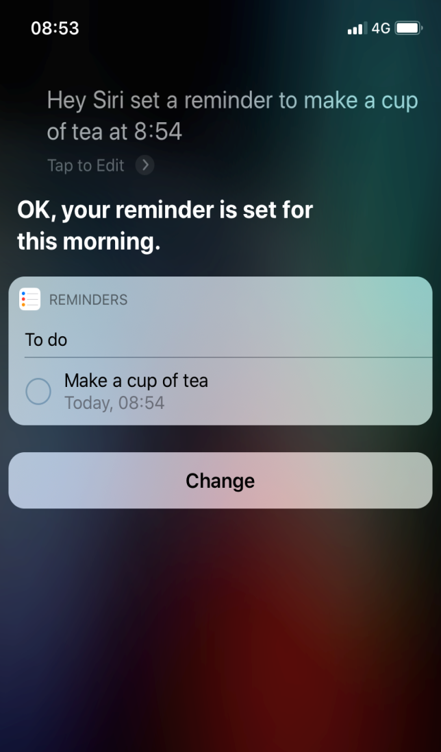
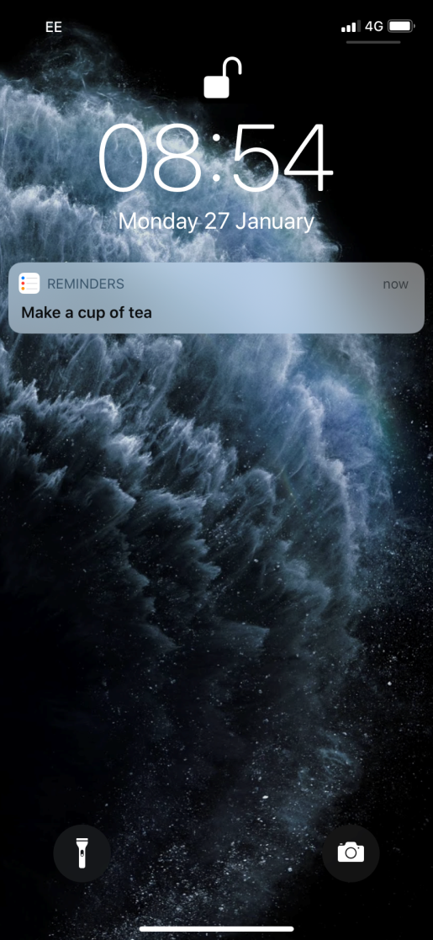
Using voice control on your phone/speaker

Slide 17


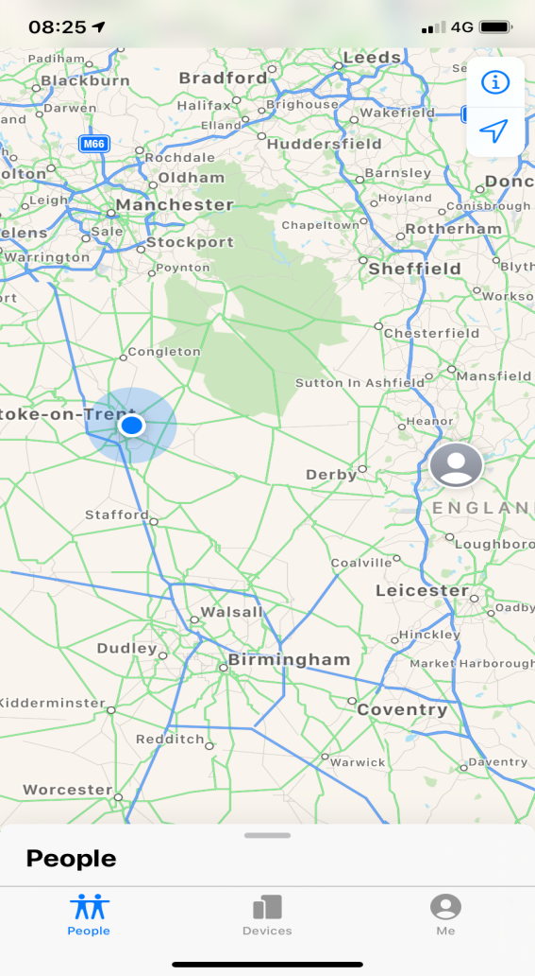
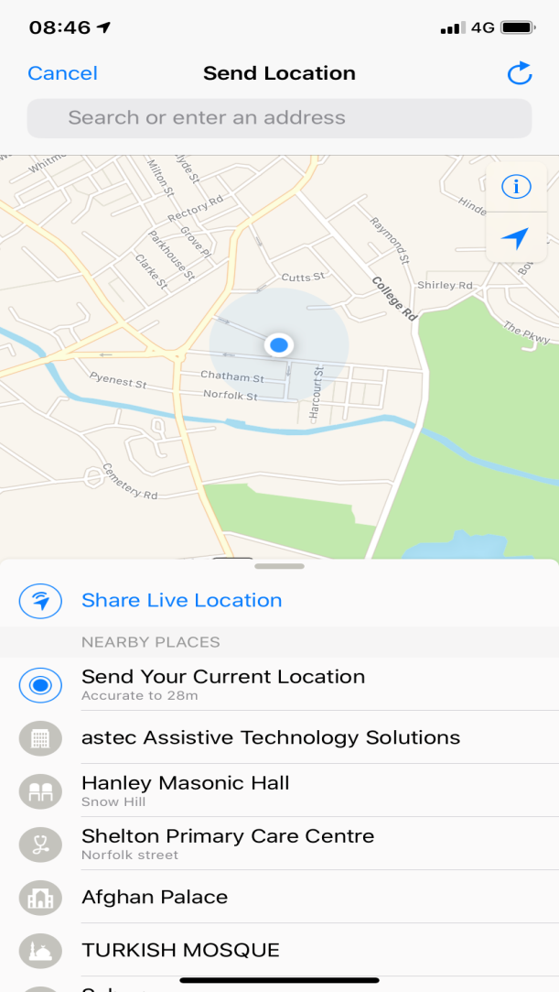
Find My Friends (IPhone)
WhatsApp

Slide 18
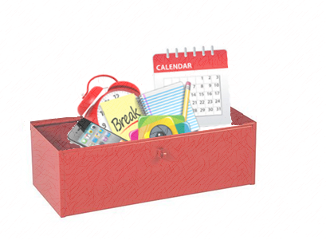
Creating a memory ‘tool box’
Making a plan about which strategies may be useful for you
Focusing on one strategy at a time
For strategies to ‘stick’ they need to become part of your routine.

Slide 19
Strategy examples
Maps (dropping a pin)
Having a meeting point
Getting all the ingredients out on the kitchen worktop and placing them in order
One thing at a time
Visualising routes
Audiobooks
Reminders on phone
Setting timers.

Slide 20
What might get in the way of using these strategies successfully?

Slide 21
Tips to get you started
Start simple
Keep it slow
Keep a routine
Choose the right time off the day to try these strategies.

Slide 22
How do I know which strategies will be most useful for me?
Do I have a specific difficulty with my memory?
Do I remember information better when I see or hear things?
Do I forget things shortly after they’ve happened or after an extended period of time?
Are you having a specific difficulty during the process of learning?
Notes:
Link to ‘difficulties’ from discussion session 2

Slide 23
Out of Session Work
Weekly
SMART goals
Review in following session
Notes:
Helpful to think about own difficulties and to identify any strategies that are already providing to be useful, share them with the group

Slide 24

Summary
Mindfulness exercise
Recap on the previous session
Communicating cognitive difficulties to others
Overview of external memory strategies
Out-of-session work.

Slide 25
Thank you for attending
Grace Sunerton, Assistant Psychologist
Jessica Haselhurt, Trainee Clinical Psychologist
01782 275188
Notes:
Contact details if you are having difficulties with the programme. There will also be space to ask any questions and explore with us your difficulties within the group if you feel comfortable sharing these.

